Slide 1
Genetic Ambassador March 2019 Call
Kristi Wees MS Chem
Director of Consumer Engagement
Social Media Coordinator
MSRGN

Slide 2
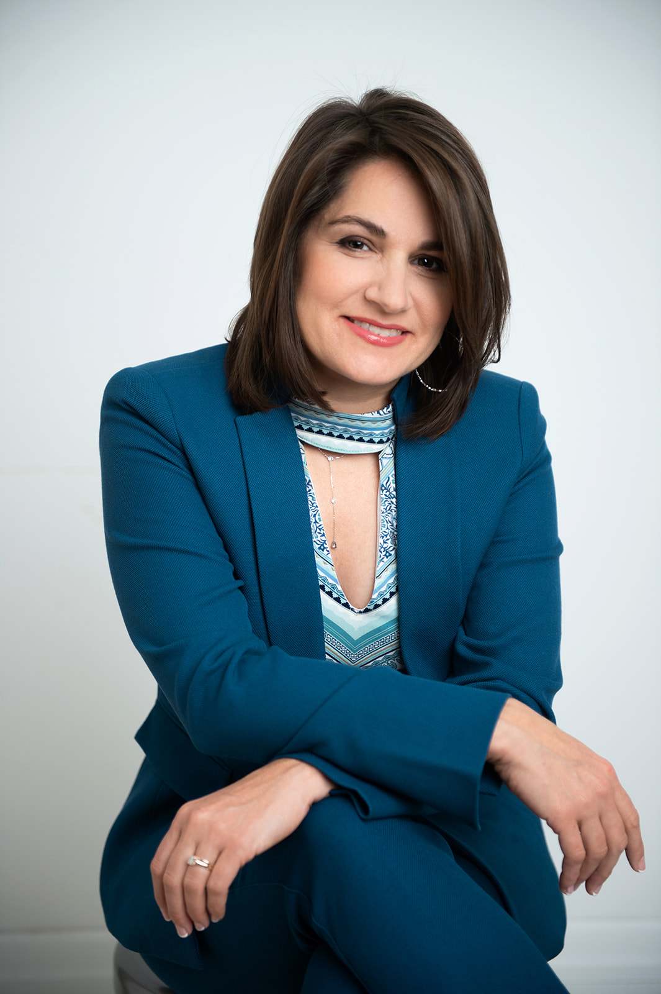
Hello!
I am Kristi Wees
Social Media Coordinator for MSRGN and MSGRC since 2012
Consumer Engagement Director for MSRGN in 2018
BS Chemistry Penn State and MS in Chemistry UCLA
A mom to a child who doctor’s suspect has a mitochondrial disease
My other hat- Patient Advocate for EmpoweredAdvocacy.com

Slide 3
Mission: To ensure that individuals with genetic disorders and their families have access to quality care and appropriate genetic expertise and information through facilitating a professional network of genetics clinics, key primary care practices, consumer advocates, and state health department resources.
Funding: This work is supported by the Health Resources and Services Administration (HRSA) of the U.S. Department of Health and Human Services (HHS) as part of an award totaling $600,000.00 with 0 percent financed with non-governmental sources. The contents are those of the author(s) and do not necessarily represent the official views of, nor an endorsement, by HRSA, HHS, or the U.S. Government. For more information, please visit HRSA.gov.

Slide 4
What is a Genetic Ambassador?

Slide 5
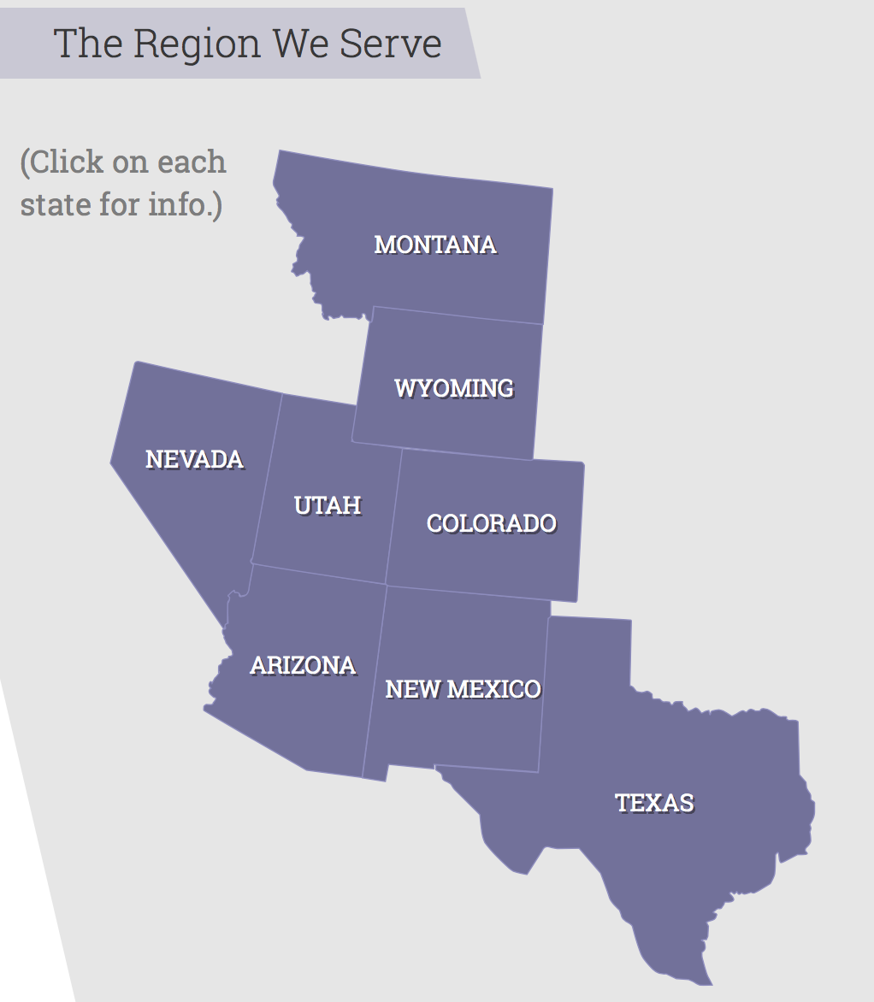
WHO?
Consumers of genetic services, and parents, family members, family leaders and individuals with genetic conditions who live in one of the states in our region:
Arizona
Colorado
Montana
Nevada
New Mexico
Texas
Utah
Wyoming

Slide 6
What’s New at MSRGN
Facebook Live! Your Genetic Questions Answered
1st one aired- Heidi Wallis
2nd scheduled for THIS WEDNESDAY 3/20

Slide 7
What is a Genetic Pop-Up ?
A Genetics Pop-up is a small (5-8 person) gathering, held in your local community, spearheaded by you, a genetic ambassador, to share genetic resources.
Details:
MSRGN will send you (Gene in a Box resource + sign in sheet)
MSRGN will provide a $300 budget to cover a $20 stipend/gift card per attendee, and the remainder of the budget may be used for food/drink (no alcohol!) at the pop-up!
Genetic Ambassadors will help by picking a date
a location (local deli, coffee shop, restaurant, etc.)
And personally invite 5-8 families, community members, educators, etc., who could benefit from genetic information, resources, and being connected to our region and MSRGN.

Slide 8
When is the Genetic Pop Up?
Time line:
Survey Monkey to apply and request a POP UP for your state will go out this week!
We have funds for ONE pop up available per state through 3/31/19. If all the pop-ups have not been claimed by 3/31, then we will open it up to multiple pop-ups from other states in our region, first come first serve.
We are asking that the pop-up date be before 5/31/19 and that receipts for reimbursement be turned in (along with a sign in sheet we will provide) before 6/30/19.

Slide 9
Scholarships Available!
Offered from the National Genetics Education and Family Support Center (Genetic Alliance, Family Voices and P2P)
Scholarship #1- The Building Partnership Skills Workshops which will be held in Kansas City, MO, April 4th-5th. Family Voices will cover travel expenses up to $1500, for flight, hotel, and meal costs. In addition, Family Voices will cover the registration fee and provide the family leader with a $300 stipend to support their time and other expenses they incur. Deadline – 3/20/19
Email Kristi ASAP if interested! Kwees@mountainstatesgenetics.org

Slide 10
Scholarships Available!
Offered from the National Genetics Education and Family Support Center (Genetic Alliance, Family Voices and P2P)
Scholarship #2- The 2019 Family Voices conference which will be held in Washington, DC, May 8th – 10th. Family Voices will cover travel expenses up to $1500, for flight, hotel and meal costs. In addition, Family Voices will cover the $150 registration fee and provide the family leader with a $500 stipend to support their time and other expenses they incur. The family leader must attend the pre-conference training entitled Leading by Convening Workshop, on Tuesday, May 7th, 1:00 – 5:00 pm. Deadline- 3/22/19
Email Kristi ASAP if interested! kwees@mountainstatesgenetics.org

Slide 11
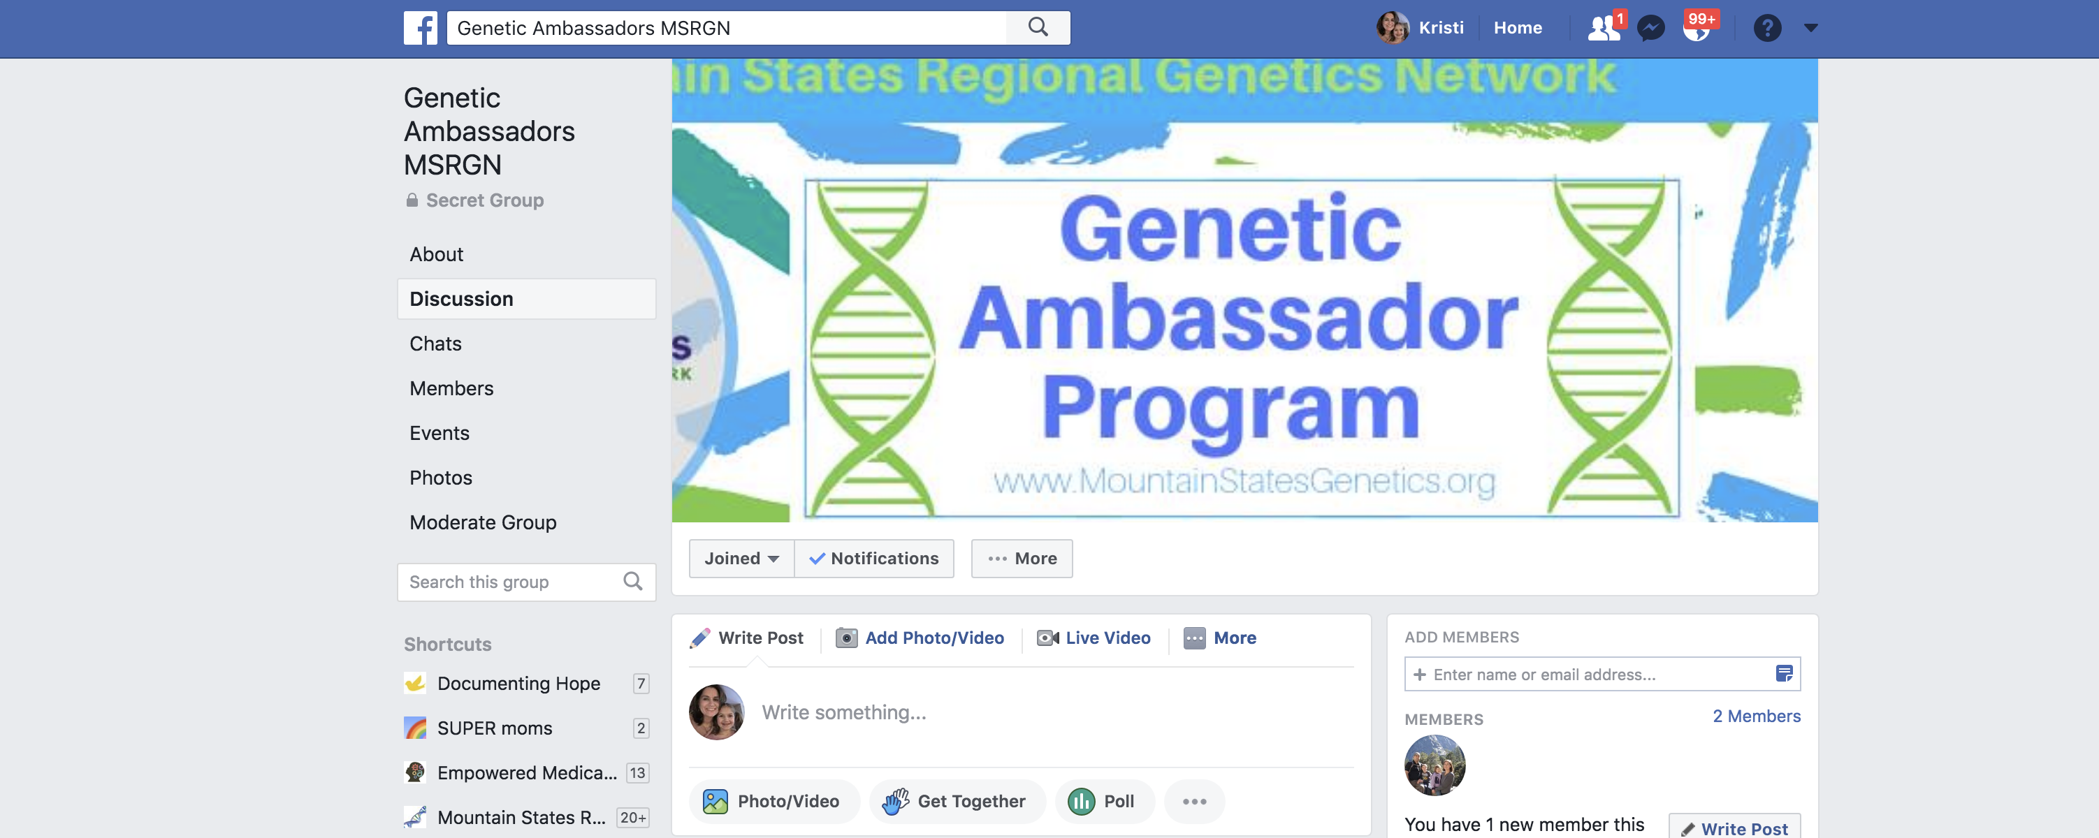
Genetic Ambassador Facebook Group
To Join- Email Kristi (kwees@mountainstatesgenetics.org)
And she will send you an invite to your email (through Facebook). Please include the email address that you use for Facebook if it is different from the one you email her from)

Slide 12
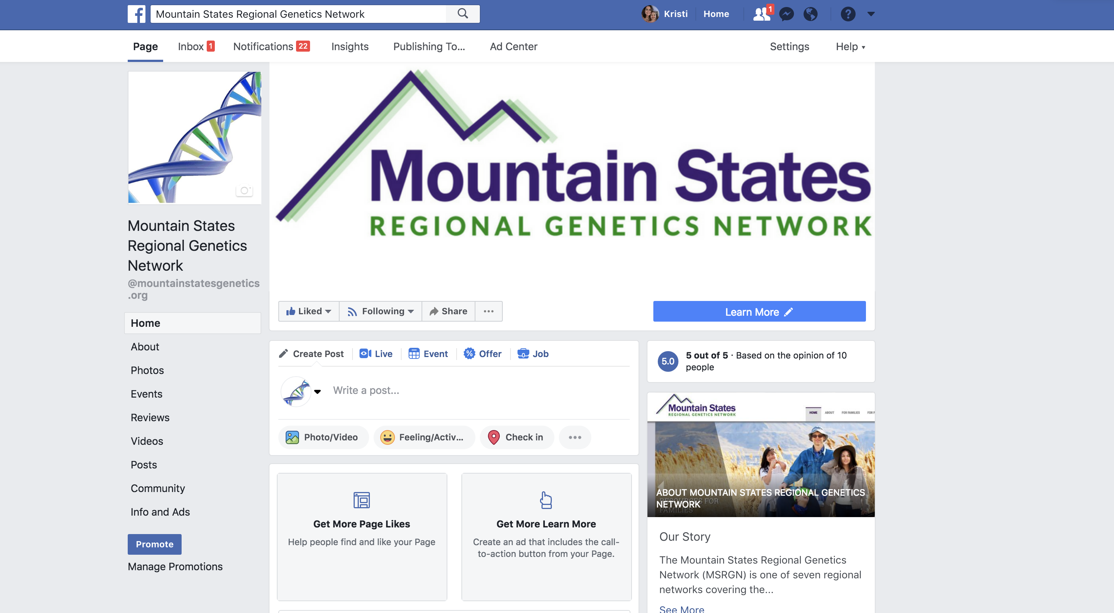
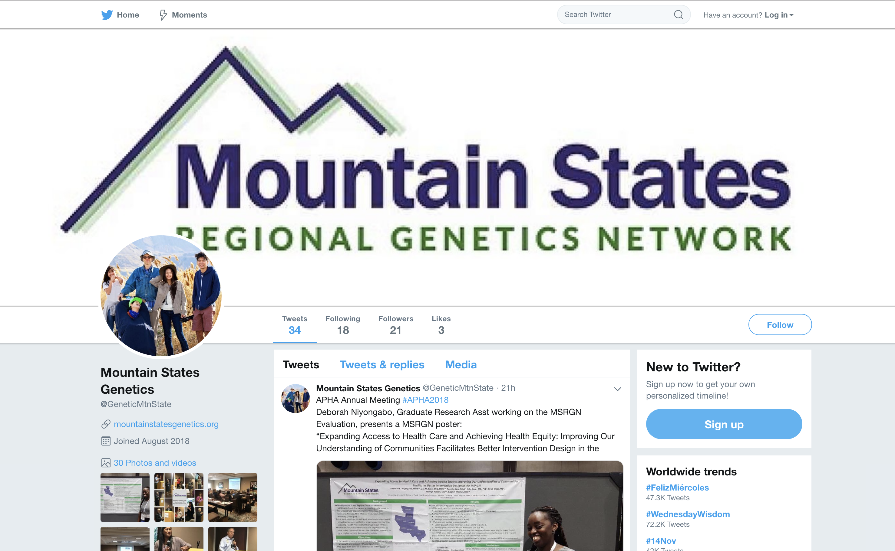
MSRGN Facebook Page and Twitter
facebook.com/mountainstatesgenetics.org/
twitter.com/GeneticMtnState

Slide 13
FACEBOOK LIVE!! This Wednesday
facebook.com/mountainstatesgenetics.org/

Slide 14
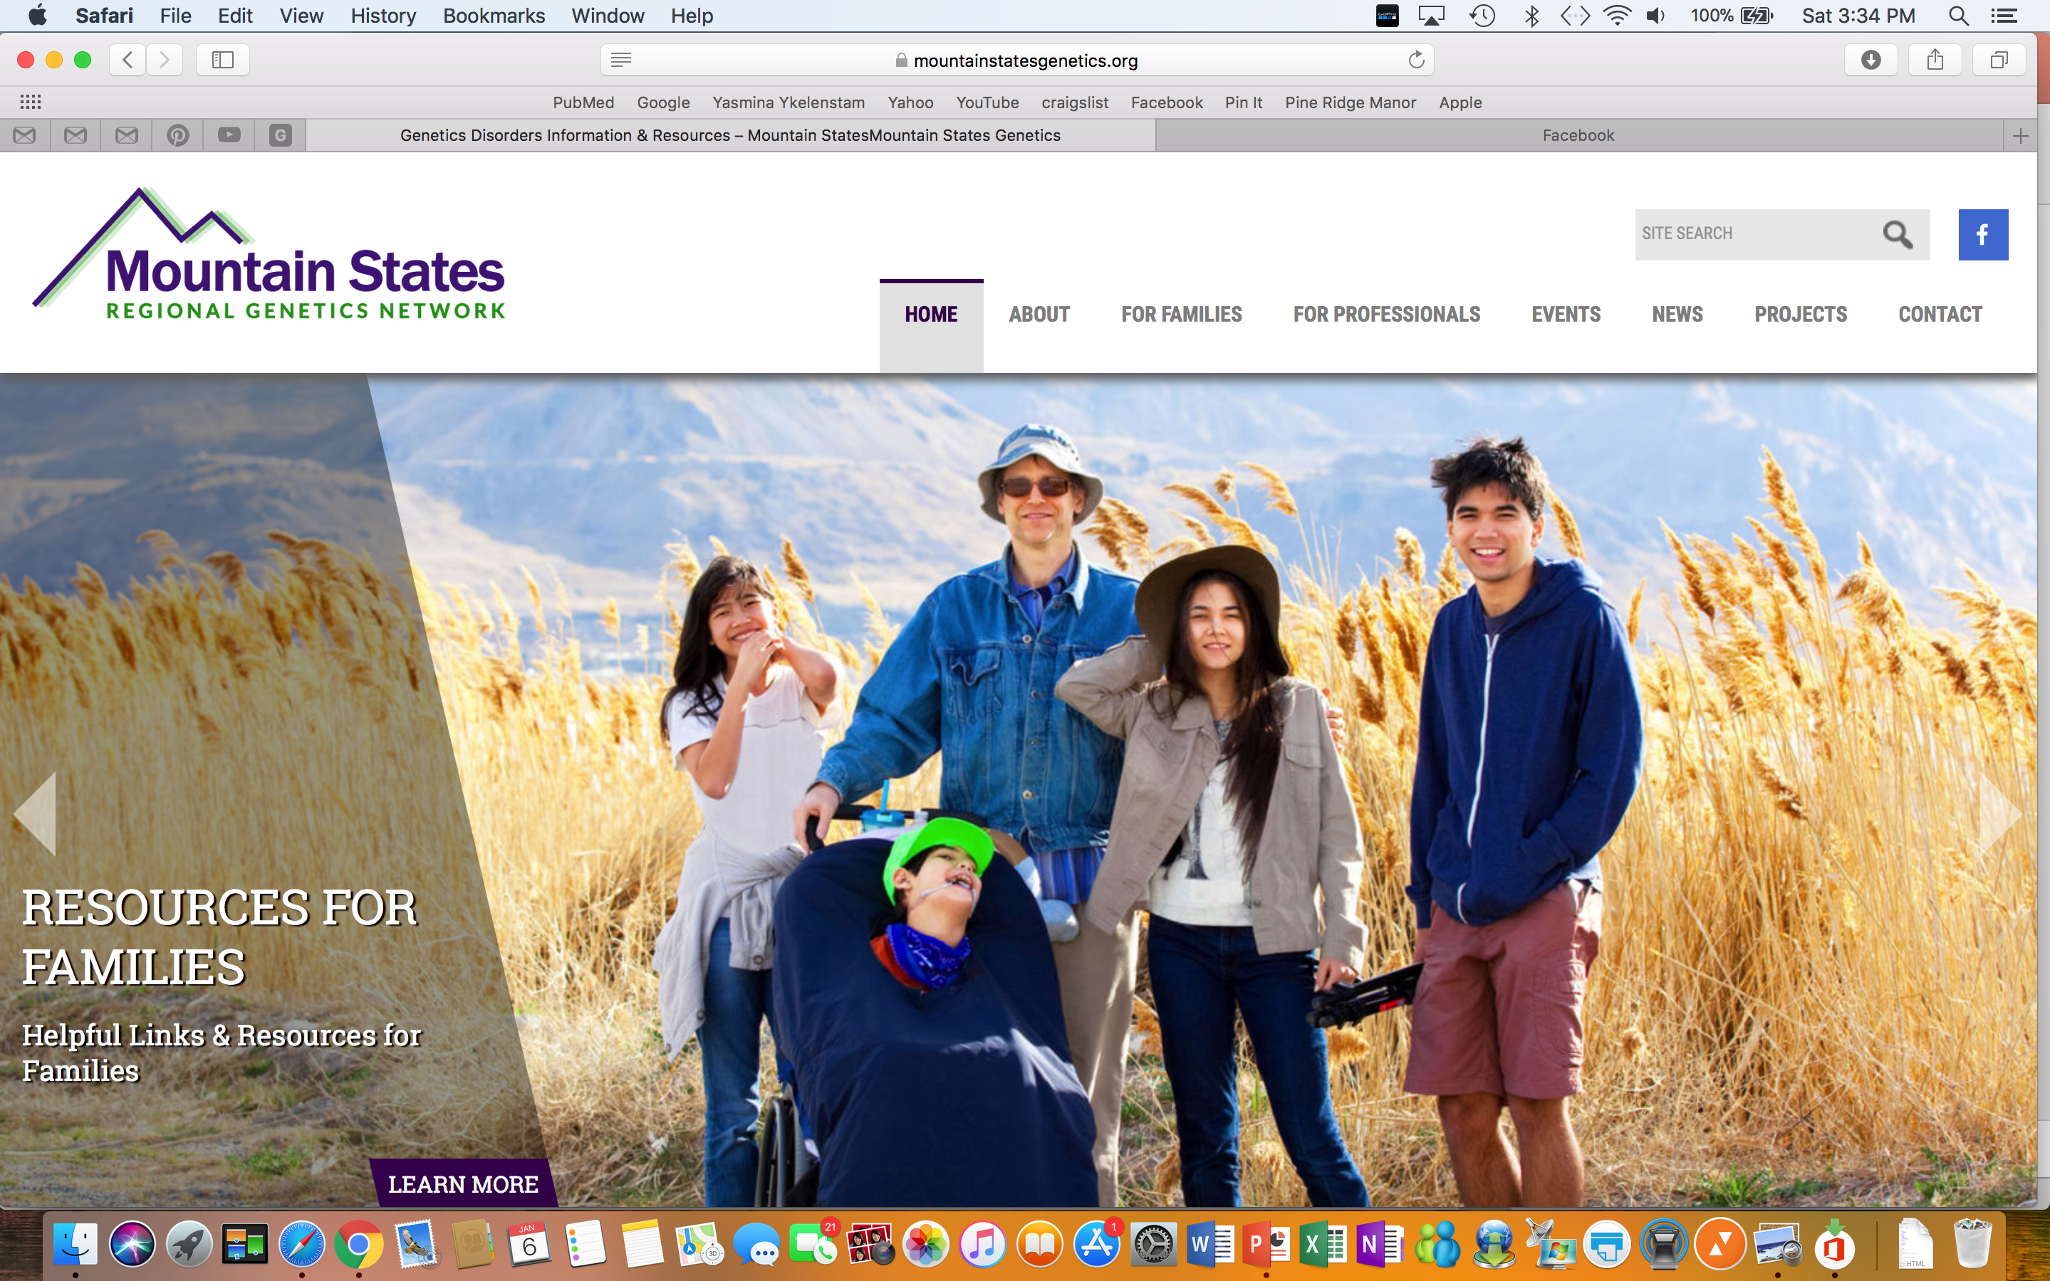
www.MountainStatesGenetics.org
Place your screenshot here
Genetic Ambassador under FOR FAMILIES TAB!

Slide 15
Thanks!
Any questions?
You can find me at
kwees@MountainStatesGenetics.org
281-831-3481 (text or call)

