Slide 1
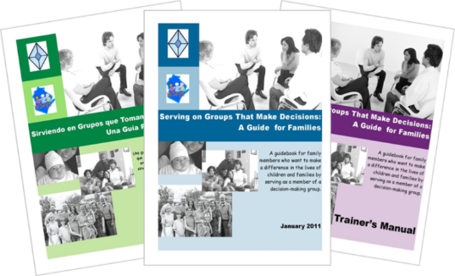
Serving on Groups That Make Decisions: A Guide for Families Section 3: Processes Groups Use
Presented by:
Kristi Wees MsChem
Mountain States Regional Genetics Network
www.servingongroups.org
Notes:
Slide #38: Welcome and Introduction -
Procedural Directions:
Have a copy of the Guidebook and the Training manual with you.
Make sure everyone has the materials needed for the presentation.
Ask if everyone can hear you and see the slides.
Introduce yourself and give a brief background of your experience (relevant to the group you are speaking to).
Address “housekeeping” such as restrooms, breaks, “parking lot”, group transitions, etc.
Presenter Notes:
Hello and welcome to this Serving on Groups that Make Decisions: A Guide for Families training.
My name is __insert name___ and I am the ___insert position__at _insert location__.
*Give a brief background of your experience (relevant to the group you are speaking to). Add information about why your family organization is offering this leadership development to families, and how your family organization is available to support and collaborate with parent leaders interested in serving on groups, and how connection to your family organization can provide support, information about challenges, barriers, and solutions for a range of diverse families, and ongoing support. This training was developed by a family-led organization, Wisconsin FACETS, and modified as part of the Family Voices National Center for Family-Professional Partnerships. F2Fs/FV SAOs are connected across the country through Family Voices and bring that national connection of shared experiences and approaches through their peer supported family organizations in every state. This nationally connected voice makes family engagement at every level stronger.
Activities

Slide 2
Section 5: Tips & Strategies for Groups
What makes effective meetings?
What improves group dynamics?
What is two-way communication?
Notes:
Slide #67: Section 5 Introduction –
Procedural Directions:
Share information from the presenter notes.
If participants have a copy of the Guidebook, guide them to the appropriate section.
Presenter Notes: TRAINERS: Sometimes group conveners or “leaders” don’t follow these guidelines for effective meetings. It is important as family representatives on these groups that you reach out to your family organization to get support to figure out how to improve group dynamics so that meetings are more effective and more open to authentic family engagement.
Effective groups use a variety of strategies to promote positive group dynamics and communication to help the group work better. Some of these strategies may be new to you. In this section, we will discuss a number of tips and strategies that groups might use.
Activities

Slide 3
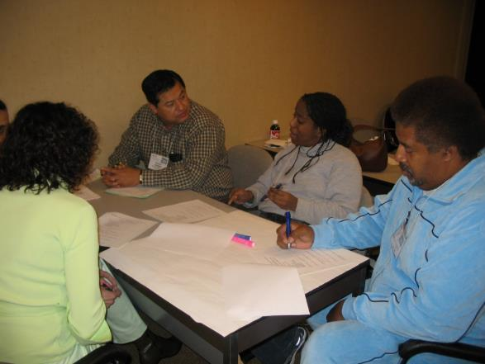
Tips for Effective Meetings
Be prepared as a group
Start and end on time
Have the information needed to make decisions
Make sure you are not missing someone who is critical to the discussion
Follow a meeting agenda
Notes:
Slide #68: Effective Meeting Tips -
Procedural Directions:
Highlight one or two tips from the slide and allow time for participants to review the list of tips.
Presenter Notes:
Here are some tips for effective meetings.
Be prepared as a group – have an agenda prepared ahead of time, send the agenda and past meeting minutes to all group members prior to the meeting, and ensure that everyone is present and ready
Start and end on time so as to be respectful of everyone’s time. The importance of being “on time” does not resonate with every culture. Speak with your group to discuss how to accommodate different cultural norms, or the needs of participants who may have other challenges such as bringing their child to school or child care, etc.
When reviewing notes from minutes, take the time to read them aloud to be mindful of individual literacy levels.
Have the information needed to make decisions. Share the information and data with the group in advance of the meeting as much as possible so that members have an opportunity to review in their own way.
Make sure you are not missing someone who is critical to the discussion. Are the people there that are needed to make the decisions a reality? Ask “Who is missing?”
Follow a meeting agenda. It keeps the meeting on track.
Activities

Slide 4
Improve Group Dynamics
Internal group strategies can include:
Have members get to know one another
Share experiences & opportunities
Use “ice breakers”
Allow time for cultural connections
An orientation for new members
A refresher for all current members
Provide training & mentorship
Give group’s background information & history
Notes:
Slide #69: Internal Group Dynamics –
Procedural Directions:
Explain the internal strategies and provide examples.
Presenter Notes:
Internally effective strategies focus on how to make the group itself function most effectively and improve group dynamics.
Strategies can include:
providing time for members to share their experiences,
playing universally accepted “ice breakers”,
allowing time for cultural connections,
providing an orientation for new members and a refresher for current members
providing on-going training & mentorship,
giving background information & history of the group,
Activities

Slide 5
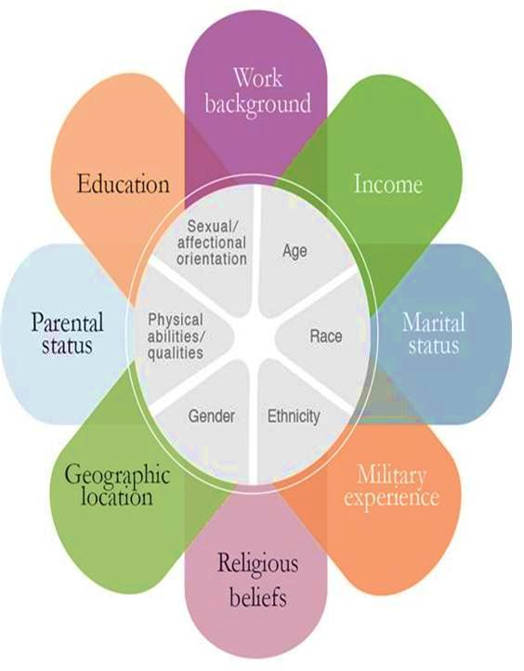
What is culture?
ME
A way of life by a group of people
Equity Alliance at ASU
Notes:
Slide #70: Culture Diagram –
Procedural Directions:
*Slide contains animation. Click to make culture definition appear.
Highlight components of the diagram (inner ring and outer petals).
Ask suggested activity question after explanation of diagram.
Presenter Notes:
What is Culture? Some definitions of culture are:
The characteristics of a particular group of people, defined by everything from language, religion, cuisine, social habits, music and arts
(http://www.livescience.com/21478-what-is-culture-definition-of- culture.html)
The customary beliefs, social forms, and material traits of a racial, religious, or social group
The characteristic features of everyday existence; a way of life shared by people in a place or time
(http://www.merriam-webster.com/dictionary/culture)
Each one of us brings our own culture to a situation or group.
Examples of culture influences may include country or language of origin, religion, socio-economic status, geographic area in which one is raised, gender, sexual orientation, etc. (This is for people that think they don’t have a culture so they can understand).
Discuss differences in culture to make people more open, honest, frank , and comfortable in sharing their story.
The inner ring of the diagram illustrates the things that are typically more of a permanent or unchanging part of who you are. There are examples that can be given that can debate some of those, but overall you can’t change your age (though you may say you are a different age than what you are).
The outer petals on the diagram are more of the changing state of who you are. Think of how much has changed in your life in the last ten years.
All of this makes up who you are, who I am, and who each parent is. Along with encouraging family engagement activities, we need to be aware that every family is unique and comes with a different cultural background.
Activities
Suggested:
Question: What changes in your life have impacted who you are today from who you were 10 years ago?
Activity Handout: Cultural Competency & Cultural Humility

Slide 6
Culturally Responsive Family Engagement
Latino Learning Modules “What is Culture?”
https://www.youtube.com/watch?v=15jdTQIr7j4
Notes:
Slide #71: Culturally Responsive Family Engagement Video Clip –
Procedural Directions:
Watch video clip. Play 1:39 to 3:26. Make your computer is connected to speakers or an audio system. https://www.youtube.com/watch?v=15jdTQIr7j4
Presenter Notes:
Culture is so much more than what is on the surface.
Reflect for a moment on your own culture. What is something understood but not on the surface?
Activities

Slide 7
Cultural Reciprocity & Cultural Humility
Cultural competence can include:
mandates
laws
rules
policies
standards
practices
attitudes
Cultural Humility/ Cultural Reciprocity
is a process and a lifelong commitment to self-evaluation and critique to improve
relationships and
outcomes.
Notes:
Slide #72: Cultural Reciprocity & Cultural Humility -
Procedural Directions:
Share information from the presenter notes.
Ask suggested activity question.
Lead suggested activity.
Presenter Notes:
Cultural competency really started out by looking at how service providers worked with families Many of you might have been in other cultural competency courses, as many people started to go through classes that tried to help them master others’ cultures.
This doesn’t really work for two reasons—it’s impossible to master every other culture and this can also lead to stereotypes.
So standards of cultural competency have been helpful in many ways as mentioned on the slide, but it’s lacking in other areas. People were taking cultural competency classes that tried to help them master others’ cultures.
This doesn’t really work for two reasons—it’s impossible to master every other culture and this can also lead to stereotypes.
This is where “cultural humility” and cultural reciprocity come in.
Cultural humility is a lifelong commitment to self-evaluation and self-critique an developing beneficial and non-paternalistic relationships. It includes:
addressing power relations
and working in partnerships
Cultural reciprocity requires that the professional understand their own cultural perspectives and how they may interfere with a positive relationship with a person who is culturally different from themselves, and that the professional be willing to reveal of themselves in order to develop a reciprocal relationship with another.
Activities
Question: How does cultural competency and/or cultural humility or cultural reciprocity play a role in your personal and professional life?
Activity: Proverbs – We’re More Alike Than Different
- Small group discussion: What does a trainer bring to the table?

Slide 8
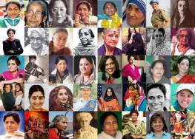
Understand Cultural Norms
Keep learning about the unique cultural values and beliefs of all members
Recognize and honor racial and ethnic variations
Provide trained interpreters
Limit the use of jargon
Encourage members to mentor one another
Utilize cultural liaisons/cultural brokers
Understand your own cultural norms, practices, & beliefs & how they affect interactions
Notes:
Slide #73: Understand Cultural Norms - Diana
Procedural Directions:
Highlight strategies for cultural norms.
Complete suggested activity.
Presenter Notes:
So to understand cultural norms and increase the participation of families from all diverse backgrounds, here are some strategies.
Keep learning about the unique cultural values and beliefs of ALL members of the group and the communities the group is serving. Remember, there should be representation and/or considerations of all demographic groups within a community.
Take time to recognize and honor racial and ethnic variations
Provide trained interpreters
Limit the use of jargon
Encourage members to mentor each other to build skills and confidence
Utilize cultural liaisons to help inform the group as well as connect people in the community to the work of the group
Example: A national project wanted to work with family organizations to help decrease obesity in Native American/Indian children. Feedback – wisdom - from Native families indicated that use of the term “obesity” was negative and would likely decrease increase and participation among Native families. They suggested instead wording, “healthy family eating,” which was much more welcoming and had great success.
Remember that working closely with a family led organization can help you as a family leader learn more about the cultural values and beliefs of a broader range of diverse families so that you can help bring those thoughts and perspectives to the table
Activities
Question: What are some additional ideas or strategies to increase participation from diverse communities?

Slide 9
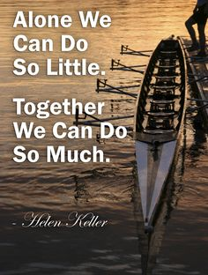
Alone we can do so little;
together we can do so much.
-Helen Keller
Notes:
Slide #74: Quote -
Procedural Directions:
Share Helen Keller quote.
Presenter Notes:
Read quote “Alone we can do so little; together we can do so much.”
What is needed to be able to work with others? How can working with a family-led organization to support you in your role on an advisory or decision making group make you be able to do “so much?”
Activities

Slide 10
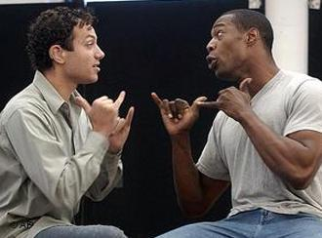
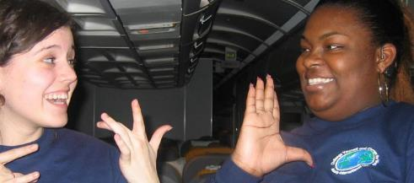
Two-Way Communication
External strategies can include:
Town meetings
Public listening sessions of local, state, or national agencies
MCHB Block Grant hearings
‘Breakfast with the Policymaker’
Policy forums
Health, education, disability, etc.
Notes:
Slide #75: Two-Way Communication -
Procedural Directions:
Explain the external strategies and provide examples.
Presenter Notes:
Externally effective strategies concentrate on how to build effective practices with the individuals who will be most affected by the decisions of the group. Strategies can include:
town meetings,
public listening sessions of local, state, or national agencies,
MCHB Block grant hearings
‘Breakfast with the Policymaker’
Health, education, disability, etc.
When speaking to external groups, if your role is one of soliciting input from parents in order to ascertain their opinions and ideas, one needs to be careful not to appear to be “speaking on behalf” of a group.
Activities

Slide 11
Section 5 Resources
Techniques for Improving Meeting Effectiveness
http://www.effectivemeetings.com/
Running Effective Meetings and Facilitating Groups (2002)
http://sabes.org/resources/facilitationguide.pdf
Facilitating Groups to Drive Change (B. Buechel)
http://www.imd.ch/research/challenges/TC069-08.cfm
National Center for Cultural Competence
http://nccc.georgetown. edu/
Cultural reciprocity
http://eric.ed.gov/?id=ED400251
Notes:
Slide #76: Section 5 Resources
Procedural Directions:
Highlight 1 or 2 online resources listed on the slide.
Have one or two web links accessible and ready to show.
Presenter Notes:
Techniques for Improving Meeting Effectiveness
http://www.effectivemeetings.com/
Running Effective Meetings and Facilitating Groups (2002)
http://sabes.org/resources/facilitationguide.pdf
Facilitating Groups to Drive Change by Bettina Buechel
http://www.imd.ch/research/challenges/TC069-08.cfm
Activities
Handout: Guidebook Sectional Resource List

